Slide 1
Multimedia Applications
BCT 2207: MULTIMEDIA APPLICATIONS
S.Kiptioo, Computing Department SCIT
skiptoo@jkuat.ac.ke

Slide 2
What is Multimedia?
Derived from the word “Multi” and “Media”
Multi
Many, Multiple,
Media:
Tools that are used to represent or process, delivery medium, a form of mass communication – newspaper, magazine / tv.
Distribution tool & information presentation – text, graphic, voice, images, music and etc.

Slide 3
Components of Multimedia
• Multimedia involves multiple modalities of text, audio, images, drawings, animation, and video.
Examples of how these modalities are put to use:
Video teleconferencing.
Distributed lectures for higher education.
Tele-medicine.
Co-operative work environments.
Searching in (very) large video and image databases for target visual objects.
“Augmented” reality: placing real-appearing computer
graphics and video objects into scenes.

Slide 4
Challenges of Multimedia Computing
Developing a successful multimedia system is challenging.
Continuous media types such as video need a lot of space to store and very high bandwidth to transmit.
They also have tight timing constraints.
Automatically analyzing, indexing and organizing information in audio, image and video is much harder than from text.
Multimedia involves many different research areas and needs more complex and more efficient algorithms and hardware platforms.

Slide 5
Multimedia is Multidisciplinary
Computer
networks,
operating system
Multimedia
computing
Computer vision,
pattern recognition
Image, audio, speech processing
Human computer
interaction
Computer
graphics

Slide 6
What is Multimedia
It is any combination of text, graphic art, sound, animation, and video delivered to you by computer or other electronic means (iphones, or any smart phone).
The essence of multimedia is to electrify the thought and action centres of people’s mind.
Multimedia excites eyes, ears, fingertips, and most importantly, the head.

Slide 7
General Definition
It is a woven combination of text graphic art, sound, animation, and video elements.

Slide 8
concepts
When you allow an end user – the viewer of multimedia project – to control what and when the elements are delivered it is called interactive media.
When you provide a structure of linked elements through which the user can navigate, interactive multimedia becomes hypermedia.

Slide 9
Important Note
People who know how to use multimedia computer tools and technologies to weave them together are called multimedia developers.
The software vehicle, the messages and the content presented on a computer or television screen – together constitute multimedia project.

Slide 10
Important Note-tools
Project may be a page or site on the Web where you can weave the elemnts of multimedia into html (Hypertext Mark up Language) DHTML (Dynamic Hypertext Mark up Language) documents and use plug-ins like Macromedia’s Flash, Adobe’s Flash, or Apple’s Quick Time to display multimedia using browser such Mozilla Firefox and Internet Explorer.

Slide 11
Uses of Multimedia
Multimedia is appropriate whenever a human interface, connect a human user to electronic information of any kind. There are number of uses
Uses in Business.
Multimedia in Schools.
Multimedia in Home.
Multimedia in Public Places.
Virtual Reality

Slide 12
Uses in Business
Business applications for multimedia include presentations, training, marketing, advertising, product demos, databases, catalogues, and networking communications.

Slide 13
Uses in Business
Uses in training programs.
Flight attendants learn to manage international terrorism and security through simulation.
Mechanics learn to repair engine
Salespeople learn about product lines and leave behind software to train their customers.
Fighter, pilots practice full-terrain sorties before spoiling up for the real thing.

Slide 14
Multimedia in Schools
It can be used in schools helping student to learn.
An iteresting use of multimedia in schools involves the student themselves.
Nowadays students put interactive magazines and newsletters, streamline videos, and podcasting (Audio and Video) through smart phone or Web.

Slide 15
Multimedia in Home
It is used home in various ways from gardening to cooking to home design, remodeling, and repair to genealogy software.
Game players machine available in home.
Internet gaming for home internet users.

Slide 16
Multimedia in Public Places
Big animated screen are now available in public to provide information and help to public.
Hotels, train, banks, shopping malls, airports, groceries, e.t.c.

Slide 17
Virtual Reality (VR)
VR is a new multimedia technology that attempt to put a person “inside” a lifelike experiences.
VR requires a terrific computing power to be realistic.
In VR your cyberspace is made up pf many thousands of geometric objects plotted in 3D space.

Slide 18
Virtual Reality (VR)
On the Web, standards for transmitting virtual reality worlds or scenes in VRML (Virtual Reality Modeling Language) documents have been developed.
By using highly dedicated VR is now used in building flights by developing first flight simulators before building actual planes.
In military plane like F-16 and F-17, Boeing 777.

Slide 19
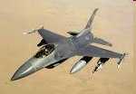
Virtual Reality
F – 16 Fighter Plane

Slide 20
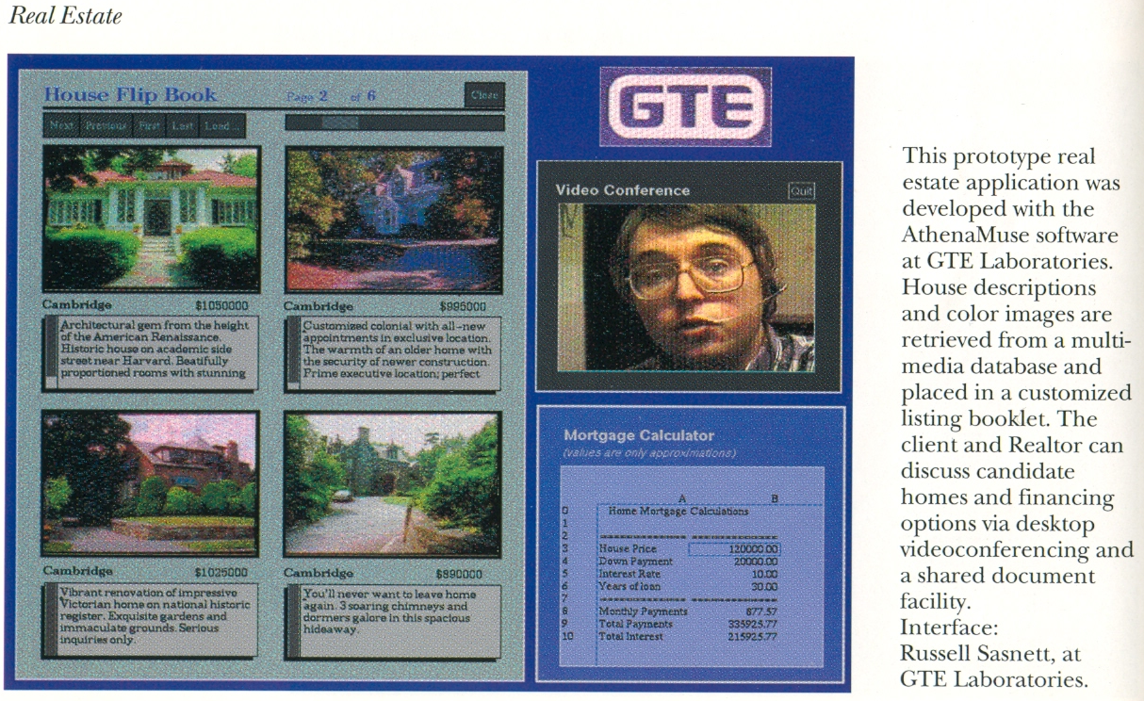
Example Multimedia Systems
Real Estate in MIT’s Project Athena

Slide 21



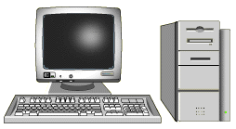
Example: A Course-on-Demand System
On-line facilitator
Courseware
developer
Network
Multimedia
Database
Database server
user

Slide 22
A Course-on-Demand System
Metadata
DB
Authoring
Tool
Java Client
Network
Server
DB Application
Integration Software
User
Interface
Media
Server

Slide 23
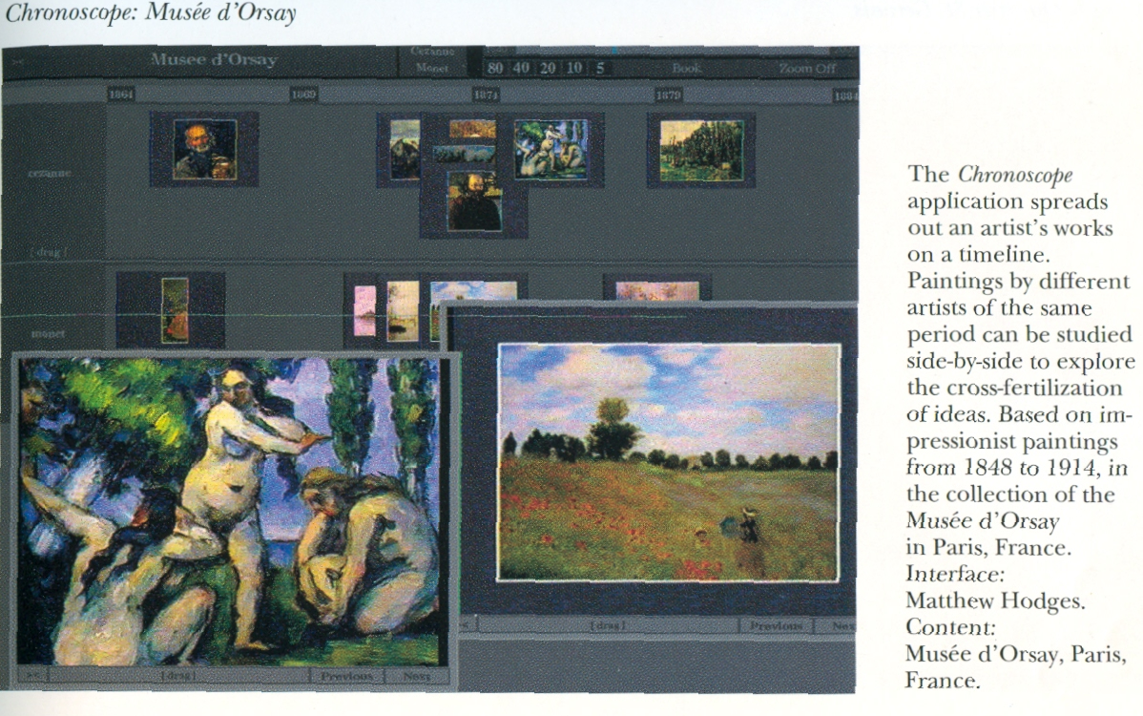
Example Multimedia Systems
Chronoscope in MIT’s Project Athena

Slide 24
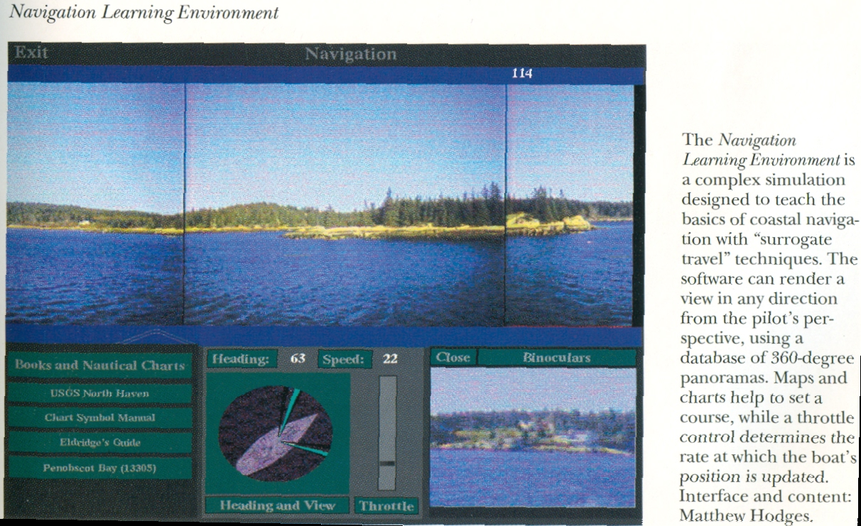
Example Multimedia Systems
Navigation Learning Environment in MIT’s Project Athena

Slide 25
Multimedia Computing
Multimedia systems involve some basic enabling techniques:
Multimedia data representation and compression.
Multimedia data processing and analysis.
Transmitting multimedia data through communication networks.
Multimedia database, indexing and retrieval.

Slide 26
Operational Definition of Multimedia
Multimedia is a combination of text, graphic, sound, animation, and video that is delivered interactively to the user by electronic or digitally manipulated means.
GRAPHIC
TEXT
MULTIMEDIA
VIDEO
AUDIO
ANIMATION

Slide 27
Elements of Multimedia
TEXT
GRAPHIC
TEXT
MULTIMEDIA
AUDIO
VIDEO
ANIMATION
A broad term for something that contains words to express something.
Text is the most basic element of multimedia.
A good choice of words could help convey the intended message to the users (keywords).
Used in contents, menus, navigational buttons

Slide 28
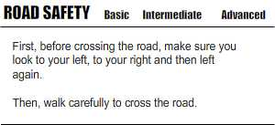
Elements of Multimedia
TEXT
GRAPHIC
TEXT
MULTIMEDIA
AUDIO
VIDEO
ANIMATION
Example

Slide 29
Elements of Multimedia
TEXT
GRAPHIC
GRAPHIC
MULTIMEDIA
AUDIO
VIDEO
ANIMATION
Two-dimensional figure or illustration
Could be produced manually (by drawing, painting, carving, etc.) or by computer graphics technology.
Used in multimedia to show more clearly what a particular information is all about (diagrams, picture).

Slide 30
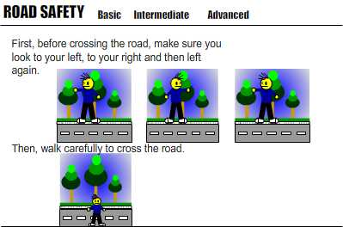
Elements of Multimedia
TEXT
GRAPHIC
GRAPHIC
MULTIMEDIA
AUDIO
VIDEO
ANIMATION
Example

Slide 31
Elements of Multimedia
TEXT
GRAPHIC
AUDIO
MULTIMEDIA
AUDIO
VIDEO
ANIMATION
Produced by vibration, as perceived by the sense of hearing.
In multimedia, audio could come in the form of speech, sound effects and also music score.

Slide 32
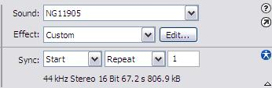
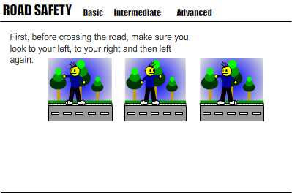
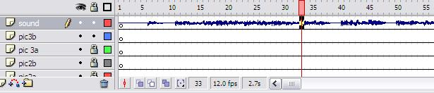
Elements of Multimedia
TEXT
GRAPHIC
AUDIO
MULTIMEDIA
AUDIO
VIDEO
ANIMATION
Example

Slide 33
Elements of Multimedia
TEXT
GRAPHIC
ANIMATION
MULTIMEDIA
AUDIO
VIDEO
ANIMATION
The illusion of motion created by the consecutive display of images of static elements.
In multimedia, animation is used to further enhance / enriched the experience of the user to further understand the information conveyed to them.

Slide 34
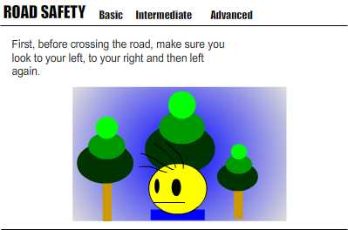
Elements of Multimedia
TEXT
GRAPHIC
ANIMATION
MULTIMEDIA
AUDIO
VIDEO
ANIMATION
Example

Slide 35
Elements of Multimedia
TEXT
GRAPHIC
VIDEO
MULTIMEDIA
AUDIO
VIDEO
ANIMATION
Is the technology of capturing, recording, processing, transmitting, and reconstructing moving pictures.
Video is more towards photo realistic image sequence / live recording as in comparison to animation.
Video also takes a lot of storage space. So plan carefully before you are going to use it.

Slide 36
Interactive Multimedia
When the user is given the option of controlling the elements.
Hyper Media
A combination of hypertext, graphics, audio, video, (linked elements) and interactivity culminating in a complete, non-linear computer-based experience.

Slide 37
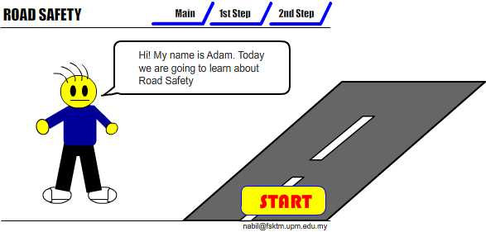
Example
Interactive Multimedia

Slide 38
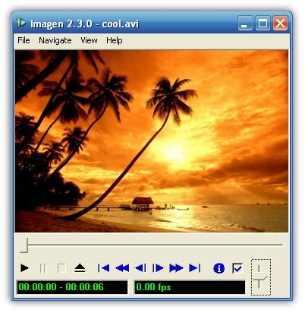


Example
Hyper Media
Main Page
Video link
Image link
Audio Link

Slide 39
Linear VS Non-Linear
LINEAR
A Multimedia Project is identified as Linear when:
It is not interactive
User have no control over the content that is being showed to them.
Example:
A movie
A non-interactive lecture / demo show

Slide 40
Linear VS Non-Linear
NON-LINEAR
A Multimedia Project is identified as Non-Linear when:
It is interactive
Users have control over the content that is being showed to them.
Users are given navigational control
Example:
Games
Courseware
Interactive CD

Slide 41
Authoring Tools
Use to merge multimedia elements (text, audio, graphic, animation, video) into a project.
Designed to manage individual multimedia elements and provide user interaction (if required).

Slide 42
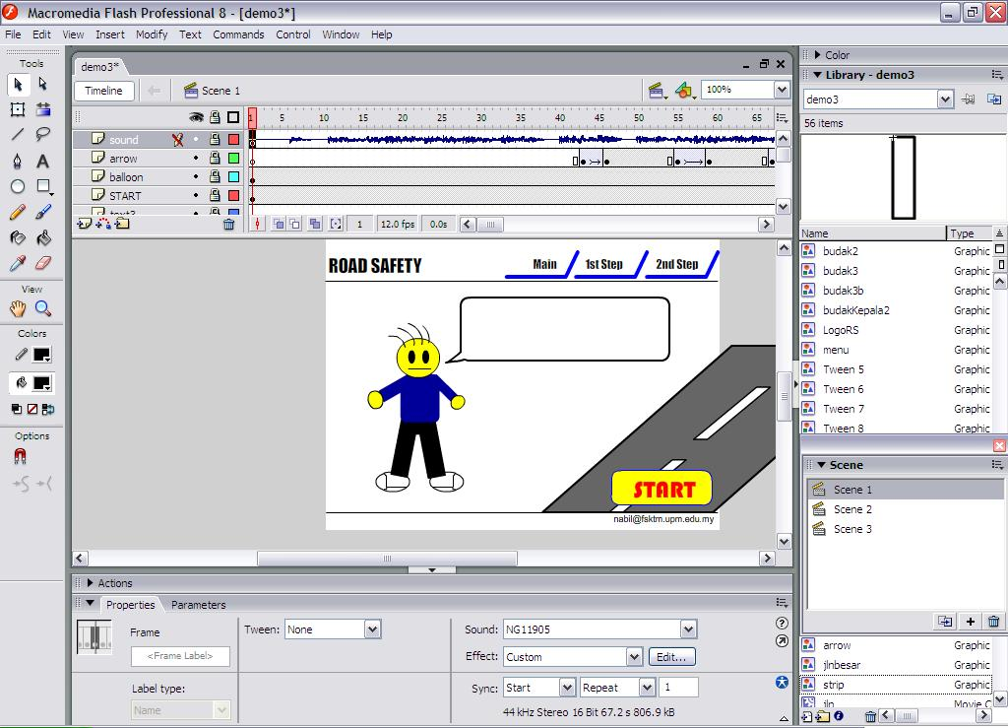
Authoring Tools
Example:
Macromedia Authorware
Macromedia Director
Macromedia Flash
Microsoft Power Point

Slide 43
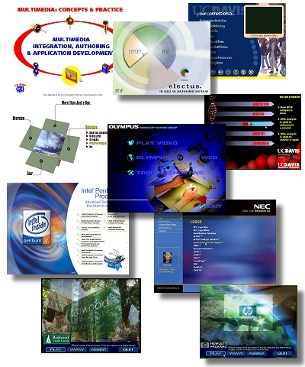
Other examples of Multimedia apps
There are a number of fields where multimedia could be of use. Examples are:-
Business
Education
Entertainment
Home
Public Places

Slide 44
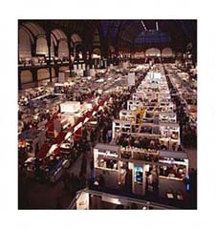
Importance of Multimedia
Business
Use and Applications
Sales / Marketing Presentation
Trade show production
Staff Training Application
Company Kiosk

Slide 45

Importance of Multimedia
Education
Use and Applications
Courseware / Simulations
E-Learning / Distance Learning
Information Searching

Slide 46


Importance of Multimedia
Entertainment
Use and Applications
Games (Leisure / Educational)
Movies
Video on Demand
Online

Slide 47



Importance of Multimedia
Home
Use and Applications
Television
Satellite TV
SMS services (chats, voting, reality TV)

Slide 48
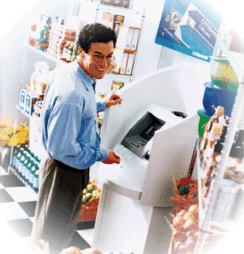
Importance of Multimedia
Public Places
Use and Applications
Information Kiosk
Smart Cards, Security

Slide 49
Multimedia Products
Briefing Products
Reference Products
Database Products
Education and Training Products
Kiosk
Entertainment and Games

Slide 50
Multimedia Products
Briefing Products
1
Small, straightforward, linear products used to present information quickly and concisely.
Characteristic of briefing product:
Short Development Cycle
Limited Number of Presentations
Usage of text to present information with limited use of graphic, audio and video.
Have few navigational controls. (mouse click and button press to move from one page to another)
Content and the format are suitable for the audience and fulfill the purpose of the presentation.
1/2

Slide 51
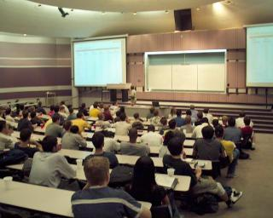
Multimedia Products
Briefing Products
1
Good briefing presentation depends on:
The understanding of the presented subject.
Seamless integration of content.
Consistent layout
Example:
Corporate Presentation
Sales Presentation
Educational Lectures
2/2

Slide 52
Hypermedia and Multimedia
• A hypertext system: meant to be read nonlinearly, by following links that point to other parts of the document, or to other documents (Fig. 1.1)
• HyperMedia: not constrained to be text-based, can include other media, e.g., graphics, images, and especially the continuous media – sound and video.
- The World Wide Web (WWW) — the best example of a
hypermedia application.
• Multimedia means that computer information can be represented through audio, graphics, images, video, and animation in addition to traditional media.

Slide 53
Multimedia Products
Reference Products
2
Often used for answering specific questions or for general browsing of information. (stored on CD/ DVD ROM)
Characteristic of reference product:
Used by wide range of user (small – adult)
Have navigational menu, book marking, searching, printing utility
2 Basic classes of reference product:
Generalized Content (dictionary/encyclopedia)
Broad treatment of content at a limited depth
Detailed Content
Focus on specific area and provide extensive information.
1/2

Slide 54
Multimedia Products
Reference Products
2
Good usability and success depends on:
The developers understanding the body of information and how the end user will want to access it.
Help function should always available to explain how to access and use the information
Examples are electronic forms of:
Encyclopedia
Dictionaries
Cookbooks, Historical, Informative
Scientific surveys.
2/2

Slide 55
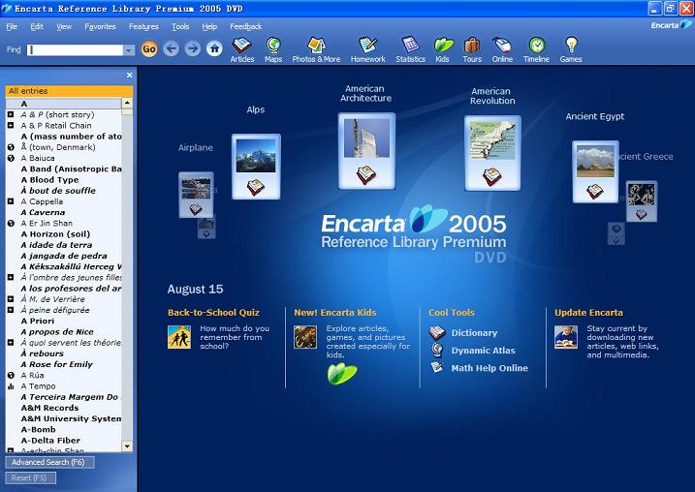
Multimedia Products
Reference Products
2
Example:
2/2

Slide 56
Multimedia Products
Database Products
3
Similar to reference product in a sense that large amount of information are made available to the end user.
Focus on storing and accessing the actual data (multimedia data such as text, graphic, audio, animation and video)
Characteristics of Database Products are:
Manages multimedia data (large data)
Descriptive finding methods
Content based search
Simultaneous access
Online database
Relational consistency in data management.
1/2

Slide 57
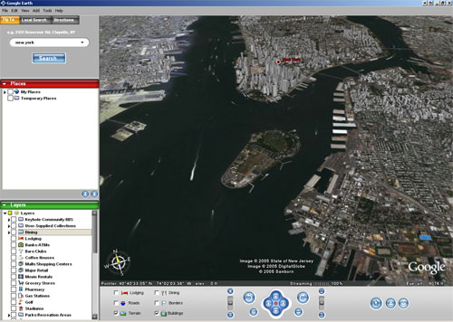
Multimedia Products
Database Products
3
Examples are:
Google Search
Google Earth
2/2

Slide 58
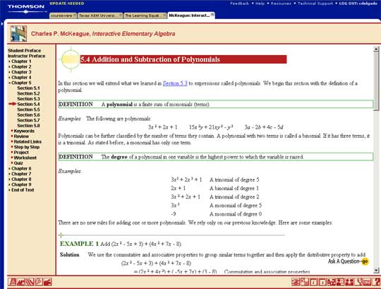
Multimedia Products
Education and Training Products
4
Similar to textbook or training manuals but have added media such as audio, animation and video.
Make up a significant share of the multimedia market ranging from pre-kindergarten to postgraduate offerings from technical to corporate training products.
2 categories of reference product:
Instructor Support Products
Standalone or Self-Paced Products
Combination Products
Shares the same characteristics as Reference Product
1/2

Slide 59
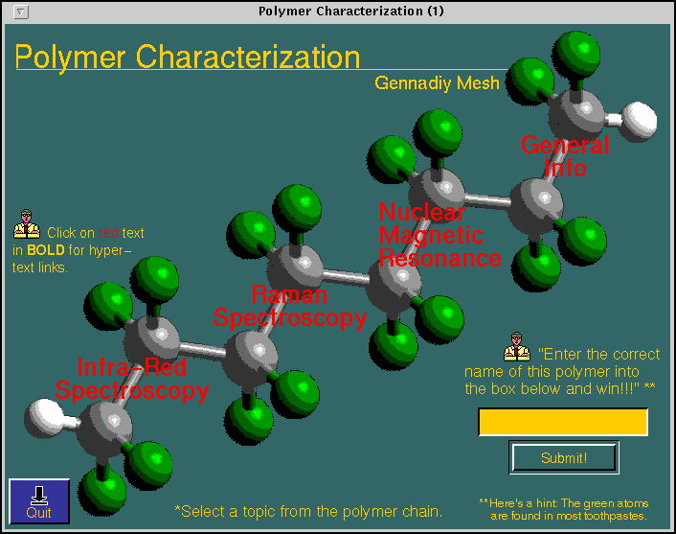
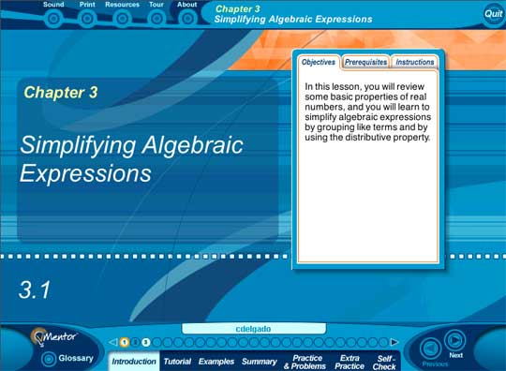
Multimedia Products
Education and Training Products
4
Example
2/2

Slide 60
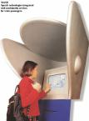
Multimedia Products
Kiosk Products
5
A product which is usually stationed at public places and allow the user to find information interactively and also other types of transaction.
Characteristics of Kiosk Products:-
Limited target users and usage.
User friendly and easily used by user.
Fast response.
1/2

Slide 61
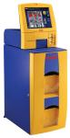
Multimedia Products
Kiosk Products
5
Categories of Kiosk
Point Of Information
Provide certain information (example map, timetable etc)
Point Of Sales System
Allow users to purchase or make orders
Example of Kiosk Products:-
Instant Photo Booth
Banking Kiosk (money deposit, cheque)
University Information Kiosk
2/2

Slide 62
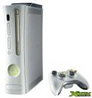
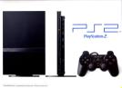
Multimedia Products
Entertainment & Games
6
Most popular
Shipped in the form of Interactive CD / DVD ROM.
Characteristics of E & G Products:-
Immersive.
Requires constant feedback and interaction with the user.
Challenging and sometimes intriguing for user
Enabled online play for more than one user experience.

Slide 63
End
Q&A

